Slide 1

Data Structures
Unit-4
Dept. of CSE,
RGUKT IIIT Srikakulam

Slide 2
Trees ( Part-1)

Slide 3
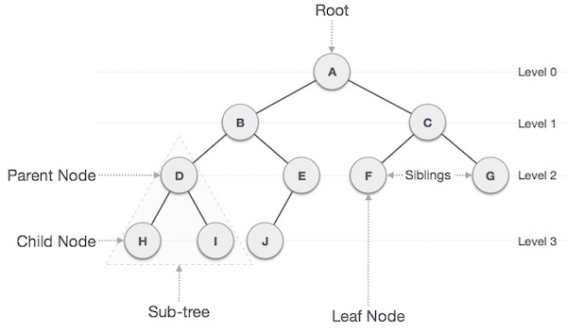
Tree:
A Tree Is recursively defined as a set of one or more nodes where one node is designated as root node and all the remaining nodes can be partitioned into non empty sets each of which is a sub tree of the root.

Slide 4

Nature View of a Tree
leaves
branches
root

Slide 5

Computer Scientist’s View
root
leaves
branches
nodes

Slide 6
Basic terminology:
Root
The top node in a tree.
Child
A node directly connected to another node when moving away from the root.
Parent
The converse notion of a child.
Siblings
A group of nodes with the same parent.
Descendant
A node reachable by repeated proceeding from parent to child. Also known as subchild.
Ancestor
A node reachable by repeated proceeding from child to parent.
Height of a node:
The height of a node is the number of edges on the longest path between that node and a descendant leaf.
Height of tree
The height of a tree is the height of its root node.

Slide 7
Basic terminology (continue):
Leaf { External node (not common)}
A node with no children.
Branch node / Internal node
A node with at least one child.
Degree
For a given node, its number of children. A leaf is necessarily degree zero.
Edge
The connection between one node and another.
Path
A sequence of nodes and edges connecting a node with a descendant.
Level
The level of a node is defined as: 1 + the number of edges between the node and the root.
Depth
The depth of a node is defined as: the number of edges between the node and the root.
Forest
A forest is a set of n ≥ 0 disjoint trees

Slide 8
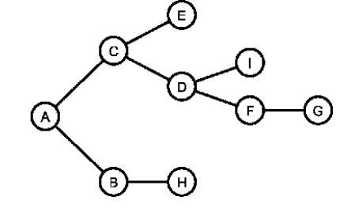
Types of Trees
General Tree
A general tree stores elements hierarchically, the top node of a tree has root node and each node except the root node has a parent.
1) A node in general tree (except leaf node) may have zero or more sub trees.
2) In General trees, if a node have at most two sub trees called as Binary trees.
3) In General trees, if a node have at most three sub trees called as Ternary trees. Etc.,
Forests
A forest is a disjoint union of trees. A set of disjoint trees is obtained by deleting the root and the edges connecting the root node to nodes at level 1.
→ By deleting A, The tree converted to Forests.

Slide 9
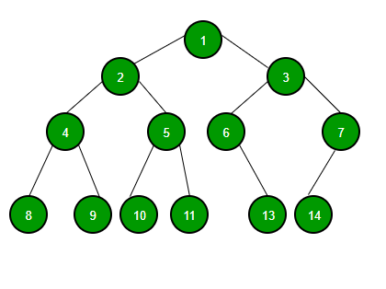
Binary Tree
A tree whose nodes have at most 2 children is called a binary tree. Since each node in a binary tree can have only 2 children, we typically name them the left and right child.
If a tree having height “h” can have
maximum of (2^h+1)-1 nodes
Minimum of h+1 nodes

Slide 10
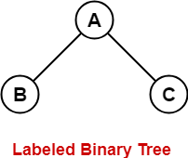
Labelled Binary Trees
A labeled tree is a tree the vertices of which are assigned unique numbers from 1 to n
Let a tree having n labelled nodes we can construct [(2n Cn)/n+1]*n! binary trees

Slide 11
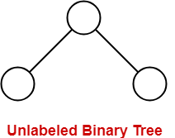
Unlabelled Binary Trees
A Binary Tree is unlabelled if nodes are not assigned any label
Let a tree having n unlabelled nodes we can construct [(2n Cn)/n+1] binary trees

Slide 12
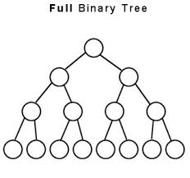
Full Binary Tree
A Binary tree is said to be Full Binary Tree, if all its internal nodes has 0 or 2 children. In other words, if all the nodes other than leaf nodes has 0 or 2 children, then that it is Full Binary Tree.
It is also called as Strictly Binary Tree/Extended Binary Tree

Slide 13
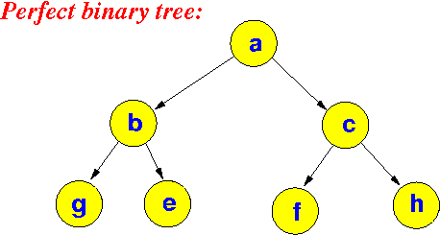
Perfect Binary Tree
A Binary tree is said to be Perfect Binary Tree, if all its internal nodes has exactly 2 children. In Perfect Binary Tree, all leaf nodes are on the same level or depth.
Nth level must be have 2^i elements , where I is level of the tree

Slide 14
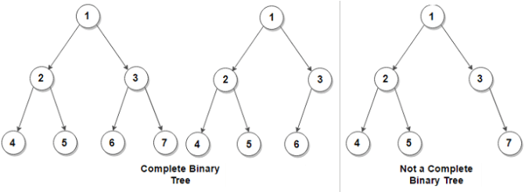
Complete Binary Tree
A Binary tree is said to be complete Binary Tree if all levels are completely filled except possibly the last level and the last level has all keys as left as possible.
All the n-1 levels should be completely filled
Nth level elements must be arranged as left as possible

Slide 15
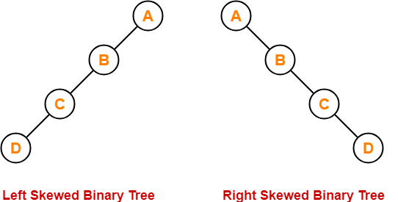
Skewed Binary Tree
Left Skewed
If tree completely going to left called as left skewed binary tree
Right Skewed
If tree completely going to right called as right skewed binary tree

Slide 16
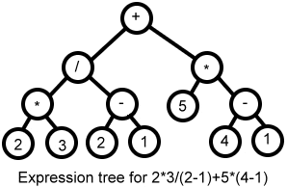
Expression Binary Tree
The tree which is used to store the Expressions

Slide 17
Trees Implementation
We can implement binary trees in 2 ways
1.Arrays
2.Linked Lists
Traversing in a Binary tree can be done in three ways:
1. In order
2. Pre order
3. Post order

Slide 18
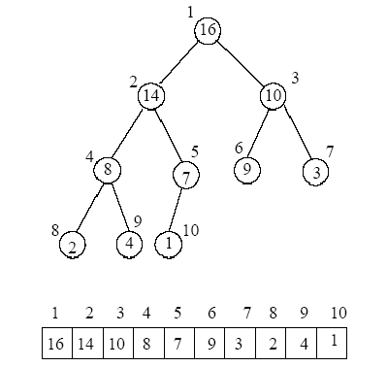
Array Representation
If Array index starts with 0 then,
Right Child Of ith node = 2i+2
Left Child Of ith node = 2i+1
If Array index starts with 1 then,
Right Child Of ith node = 2i+1
Left Child Of ith node = 2i

Slide 19
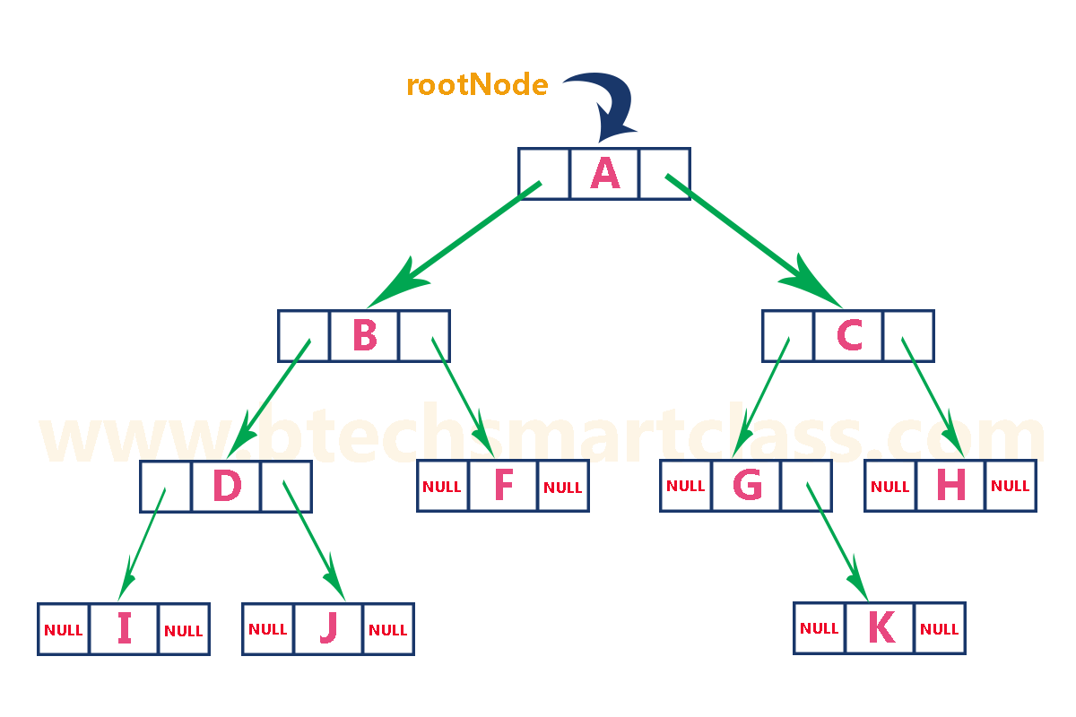
Linked List Representation
In linked representation, every node contains 3 fields:
Left Pointer
Data
Right Pointer

Slide 20
Traversing Techniques
Unlike linear data structures (Array, Linked List, Queues, Stacks, etc) which have only one logical way to traverse them, trees can be traversed in different ways.
Following are the generally used ways for traversing trees.
Pre order(H,L,R)
In order(L,H,R)
Post order(L,R,H)
L → Left R → Right H→ Head

Slide 21
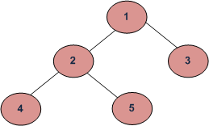
Pre Order
First we go for Head Node then Left and Then we go for Right Node
This Process Will Perform Recursively Until We get required data
It is also called as “NLR technique”
Where N → Node L → Left R → Right
Used to extract prefix notation from an expression tree.
The pre order for the following tree is 1 2 4 5 3

Slide 22
In Order
First we go for Left Node then Head and Then we go for Right Node
This Process Will Perform Recursively Until We get required data
It is also called as “LNR technique”
Where N → Node L → Left R → Right
Used to display the elements in sorted order from BST.
Solution for the following tree is 4 2 5 1 3

Slide 23
Post Order
First we go for Left Node then Right and Then we go for Head Node
This Process Will Perform Recursively Until We get required data
It is also called as “LRN technique”
Where N → Node L → Left R → Right
These are used to extract Postfix expression
Solution for the following tree is 4 5 2 3 1

Slide 24
Questions:
Construction a binary tree for the In-order traversal: D B E A F C G
Pre order traversal: A B D E C F G
Follow the class notes for procedure.

Slide 25
Applications
A binary tree can be useful to implement Huffman Tree, BST, Binary tries, hash trees, Heaps etc.,
Traversals of trees result in infix , postfix and prefix forms expressions
Storing naturally hierarchical data ex: file system (BST)
Organize data for quick search , insertion and deletion ( BST)
Trie – Dictionary
Network routing algorithms etc.,

Slide 26
Huffman Coding

Slide 27
Huffman Coding
Huffman coding is proposed by David A. Huffman in 1952
It is the one of the application of Binary Search Trees.
It is Used for compression of Files.
Compression is Nothing but reducing the size.
We use this Huffman coding in WinRar,WinZip,7zip Applications etc..,

Slide 28
Huffman Tree
It is used for to give unique encoding to a particular code or string
Properties Of Huffman Tree
It should contain root node
Internal nodes are indicated with circles( ) and it should contain weights.
External nodes are indicated with squares( )and they should contain Frequency & Characters.

Slide 29
Normal Encoding
Let we take an example
Let there are 7 characters in a string and each character is represented in 8 bits(ASCII CODES)
ASCII
a-97
b-98
c-100
d-101
BINARY(8 bits)
a-01100001
b-01100010
c-01100011
d-01100100
Binary Encoding Representation
a b c d a a b
01100001 01100010 01100011 01100100 01100001 01100001 01100001 01100010
For representing abcdaab we need 7*8=56 bits
To reduce the bits we go for frequent characters.

Slide 30
Frequent Characters Technique
In frequent characters technique the frequent occur character will take less bits and rarely occur character will take large bits.
Let’s take the previous example , in this method we first calculate frequency of characters.
Highest frequency character is represented with less bits and lowest frequency character is represented with large bits.
Representation
a-0
b-10
c-110
d-111
a b c d a a b
0 10 110 111 0 0 10
By this technique for representing abcdaab we need only 13 bits.

Slide 31
Construction Of Huffman Tree
1.Scan text to be compressed and count occurrence of all characters.
2.Sort characters based on number of occurrences in text.
3.Take 2 characters which are having least frequency as leaf nodes.
4.And sum the data of that nodes and take it as it’s parent node.
5.Take next least occurred node and compare with parent node.
6.If compared node > parent node place at right side of parent node.
7.Else place at left side of parent node and repeat the procedure from step 4.
8.Perform a traversal of tree to determine all code words.

Slide 32
Huffman Tree Logic
HT( )
{
N=Priority Queue ;
Sort(N);
for(i=1 to n-1)
{
create_Node; //Z
Z.left = min(N);
Z.right = Next_min(N);
Z.frequency=Z.left + Z.right;
push(z.frequency)
}
}

Slide 33
Key words of Huffman Tree
Internal path length
The longest path from root node to corresponding internal node.
External path length
The longest path from root node to corresponding external node.
Let n be the number of internal nodes then,
External path length = Internal path length+2*n
External weighted nodes = External path length * Frequency of External Node
Sum of External weighted nodes = storage

Slide 34
Examples
String = ab ab cba ; Occurrences = a→3;b→3;c→1;space→2;eof→1;
c,eof=1;space=2;a,b=3
2
2
2
2
1
1
→
→
Space
c eof
1
1
1
1
1
c eof
c eof

Slide 35
Continue….
Continue…..
3
4
4
4
a
2
2
→
2
2
→
2
2
Space
Space
Space
1
1
1
1
1
1
c eof
c eof
c eof

Slide 36
Continue…
Continue…..
7
3
7
b
3
4
3
4
a
a
3
4
→
a
→
2
2
2
2
2
2
Space
Space
Space
1
1
1
1
1
1
c eof
c eof
c eof

Slide 37

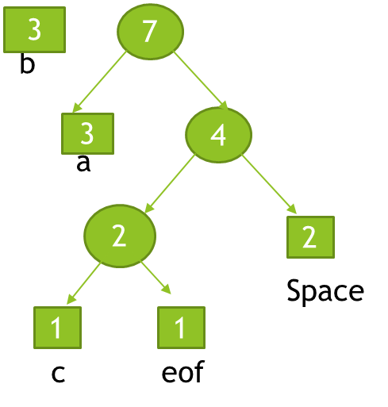
Continue..
Encode with 0’s at left side and 1’s at right side nodes of every parent node to get the representation of characters in bits.
10
Representation
b-0
a-10
c-1100
Space-111
eof-1101
→
0 1

Slide 38
Calculations For Example
For Previous Example Huffman tree
Internal Length = Sum of Internal Lengths of internal nodes
1(7)+2(4)+3(2)+0(10)=6
External length = Sum of External Lengths of External nodes
4(c)+4(eof)+3(space)+2(a)+1(b)=14
Storage = sum of weighted external nodes = sum of(external path length*frequency)
(4*1)+(4*1)+(3*2)+(2*3)+(1*3) = 23
10,7,4,2 Are Internal Nodes
c,eof,space,a,b Are External Nodes
1,1,2,3,3 Are Frequencies Of External Nodes

Slide 39
HEAP

Slide 40
Agenda
Heap
Types of heap
Procedures for inserting and deleting in heap
Heapify
Heapsort
Applications of heap

Slide 41
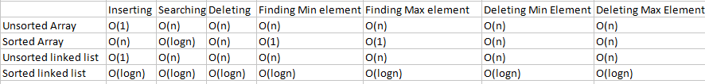
Time complexities in all cases
here the time complexities in finding and deleting min and max elements is O(n).to reduce
this time complexity we move to the heaps.

Slide 42
WHAT IS HEAP??
It is Data Structure to get efficient time complexities in finding minimum and maximum and deletion of maximum and minimum elements.
The heap should be a complete binary tree.
For insertions it takes O(log n)
Here finding min and max element it take the time complexity is O(n)
Deleting min and max elements it takes O(log n).
To find the leaf node in complete binary tree is floor(n/2 ) +1 to n , where n is the total number of nodes.

Slide 43
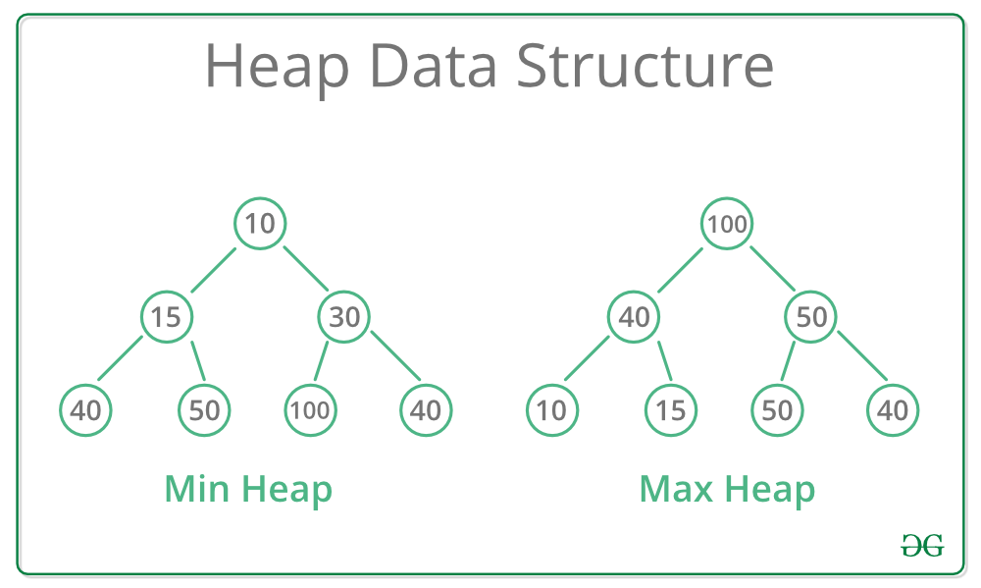
Types of heaps
MAX HEAP:
In max heap the value present in root node it must be grater than its children. This property is apply for the remaining sub tree.
MIN HEAP:
In min heap the value present in root node it must be less than the its children. this property is apply for the remaining sub tree.
Examples:

Slide 44
Procedure to insert the node in max heap
First Insert the node into the first available level or position.
Compare the inserted node with its parent. if the newly inserted node, is smaller swap it with its parent.
Continue above step until the min heap order is restored.
Procedure to insert the node in min heap
First Insert the node into the first available level or position.
Compare the inserted node with its parent. if the newly inserted node, is smaller swap it with its parent.
Continue above step until the min heap order is restored.

Slide 45
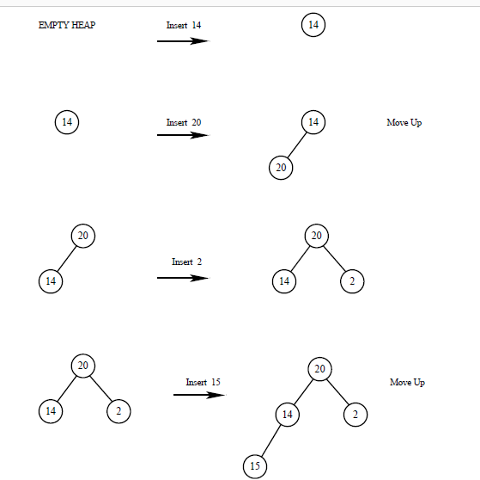
Insertion in a max heap
Let take the elements 14,20,2,15,10,21.

Slide 46
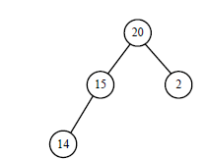
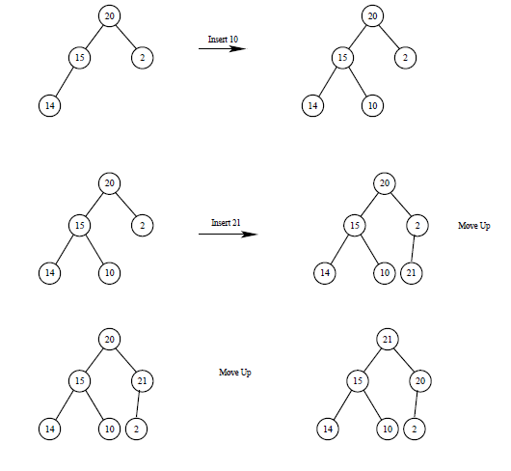

Slide 47
Procedure to deleting a node in max heap
Delete the node where you want to delete.
And replace the deleted node with rightmost value.
If the that value is smaller than the its children swap into parent node.
Otherwise remains its same.
Repeat this until hole tree holds the max heap property.
Same procedure for min heap also. but in min heap it follows its property.

Slide 48
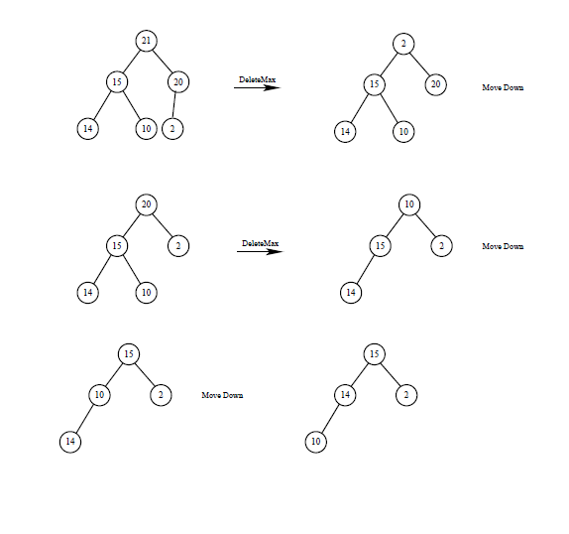
Deleting a node in max heap

Slide 49
Heapify:-The process of converting binary into max heap or minheap Converting binary tree to max heap procedure: First we have to find the index of the all non leaf nodes and find the Max index. Then take those max index node and check it with it’s left child and right child. If there is max child then swap the max element into parent node. Repeat this procedure recursively
1
2 3
4 5 6 7
8 9
here the max index position is 4 in that 16 is max value so we swap it
into parent node
17
17
19
12
19
12
7
1
20
22
16
22
1
20
16
4
7
4

Slide 50
17
17
20
22
20
19
16
19
1
12
16
22
1
12
7
4
7
4
22
Note:For better understanding check the class notes
19
20
this is the max heap
16
17
1
12
7
4

Slide 51
Heapsorting
1.Remove the topmost item (the largest) and replace it with the rightmost leaf.
2. The topmost item is stored in an array. Re-establish the heap.
3. Repeat steps 1 and 2 until there are no more items left in the heap.
The sorted elements are now stored in an array.
So this process is called heapsorting.

Slide 52
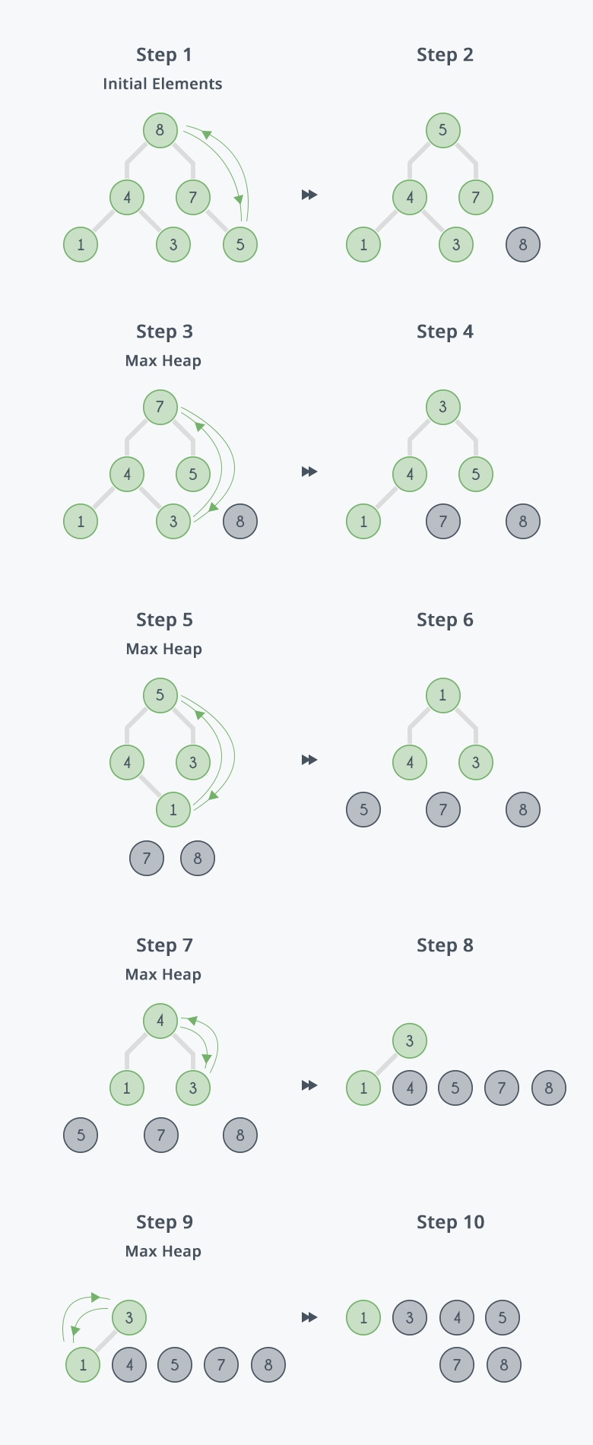

Slide 53
Application of Heap
Implementing Priority queue
Implementing Heap Sort

Slide 54
Queries???
(anilkumar10491@rguktsklm.ac.in)

